Slide 1
E-Learning
Yoga Mahesa Prima K
1501150404

Slide 2
E-Learning
E-learning according to Markus(2008) can be defined as a learning process created by interaction with digitally delivered content, network-based services and tutoring support. (Jethro, Grace, & Thomas, 2012)
The delivery of a learning, training or education program by electronic means. E-learning involves the use of a computer or electronic device (e.g. a mobile phone) in some way to provide training, educational or learning material. (Derek Stockley, 2003)
E-Learning is the use of electronic technologies to create learning experiences. (Horton, 2012)
E-learning is a term that covers many approaches, which have in common the use of ICT. E-learning is a technique of delivering educational content through Digital Interactive Television, Video-conferencing, audio-conferencing, Internet/Intranet, Worldwide Web, Video/Audio tapes, Video-on-demand, CD-ROM/DVD-ROM etc. (Mohasin, Shinde, & S, 2013)
Rieber, & Welliver, (1989) defined e- learning as “web-delivered and/or web-supported teaching and learning using computer, multimedia, and internet technologies.”

Slide 3
E-Learning 2.0
E-learning 2.0 is a kind of collaborative and user-centric learning, which is based on collective intelligence rather than a few experts’ knowledge.
These platforms enable users to share, create, and collaboratively edit knowledge content.

Slide 4
Advantages and Disadvantages of E-learning Compared to Traditional Learning in Classroom
 | Traditional Classroom learning | E-learning
Advantages | Immediate feedback | Learner – centered and self – paced
 | Being familiar to both | Time and location flexibility
 | Instructors and student | Cost – effective for learners
 | Motivating students | Potentially available to global audience
 | Cultivation of a social community | Unlimited access to knowledge
 |  | Archival capability for knowledge reuse and sharing
Disadvantages | Instructor – centered | Lack of immediate feedback in asynchronous e-learning
 | Time and location constraints | Increase preparation time for instructor
 | More expensive to deliver | Not comfortable to some people
 |  | Potentially more frustration
 |  | Anxiety and confusion

Slide 5
Benefits of e-learning
improve the quality of the learning experience
by providing new and creative ways of motivating and engaging
offering differentiated learning
wide range of tools to enable teachers and learners to be innovative, creative and resourceful
on-line communities of practice
provide an individualized learning experience for all learners
facilitate wider participation and fairer access
personalized learning support through information, advice, and guidance services
through simulations, role-play, remote control of real-world tools and devices, online master classes, or collaboration with other education providers.

Slide 6
Effective E-learning
Availability of hardware (particularly computers)
Faster Internet connectivity/improved bandwidth
Improved software
Appropriate policies favoring e-learning
Provision of technical support for e-learning at a range of scales
Lower prices for connectivity
Availability of reliable electricity
Appropriate content in appropriate languages
Awareness rising about the value of e-learning
Improved training for teachers in e-learning at all levels.

Slide 7
Synchronous E-Learning and Asynchronous E-learning
Synchronous E-Learning
Synchronous E-Learning establishes contact between instructors and students at the real time. Examples of Synchronous Learning are live radio/live interactive television broadcasting videoconferencing, teleconferencing, chatting, on-line seminar etc.
Asynchronous E-Learning
Asynchronous E-Learning doesn’t establish contact between instructor’s students at the real time. Examples include extraction of knowledge through CD or DVD or video or audio tapes or through web pages. Correspondence through E-mail falls under this category.

Slide 8
Types of E-learning
Virtual Classroom
Online Learning
Mobile Learning
Corporate E-Learning - communicating, training and enhancing employee value across the organization and countries

Slide 9
Successful E-learner
Communication
Teamwork
Problem Solving
Initiative and Enterprise
Planning and Organizing
Self-management
Learning
Technology

Slide 10
Designing E-learning
Identify your underlying goal
Analyze Learner’s needs and abilities
Identify what to teach
Set learning objectives
Identify prerequisites
Pick the approach to meet each objective
Decide the teaching sequence of your objectives
Create objects to accomplish objectives
Create test
Select learning activities
Absorb
Do
Connect
Choose media

Slide 11
E-learning breakthrough
E-learning industry today is based on three pillars:
Content
Distribution of content
e-Learning platforms

Slide 12
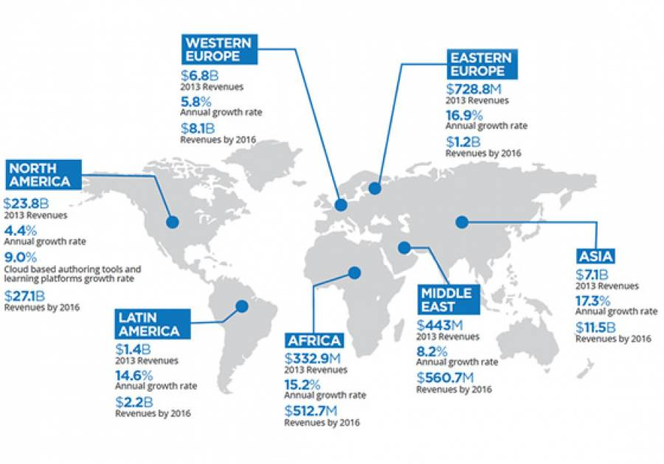
E-learning Growth

Slide 13
Thank You
Q&A

