Slide 1
Technopreneurship
Yoga
Hendrik
06PBM

Slide 2
Technopreneurship
Is the process of merging technology and entrepreneurial talent skills

Slide 3
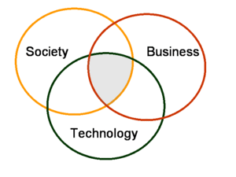
Why Technopreneurship?

Slide 4
Why not doing it?
Not taught to become a business owner
No capitalization
Lack of expertise
Fear taking the first step

Slide 5
The secret of a Technopreneur
IDEA
Business Model
Customer experience
Failure as a part
Your character

Slide 6
IDEA
A concept which can be used for commercial purposes

Slide 7
Business Model
Describes the rationale of how an organization creates, delivers, and captures value.

Slide 8
Customer Experience
Customer is the main focus of the business
Try to fulfill customer need
Learn from customer

Slide 9
Failure as a part
Starting business
Risk + Fail = Success

Slide 10
Your Character
Good habit
Negotiable
Persuade
CRM

Slide 11
Example of Technopreneur
Facebook
Waze
Ebay
Tokobagus
Etc

