Slide 1
Yoga Mahesa Prima K
1501150404

Slide 2
E-Business Risk

Slide 3
Content
E-business Risk
System Development Risk
Correlation of Profitability and Risks
Risk Exposures
Risk Concept
Project Risk Assessment Framework
Risk Management Process

Slide 4
E-business Risk
The probability of loss inherent in an organization's operations and environment (such as competition and adverse economic conditions) that may impair its ability to provide returns on investment.

Slide 5
System Development Risk
Lyytinen said “14 system development risks have been categorized using Levitt’s sociotechnical Model”.
Scoot already categorized it to 3 group strategic risks, organizational risks, and policy risk.

Slide 6
Correlation of Profitability and Risks

Slide 7
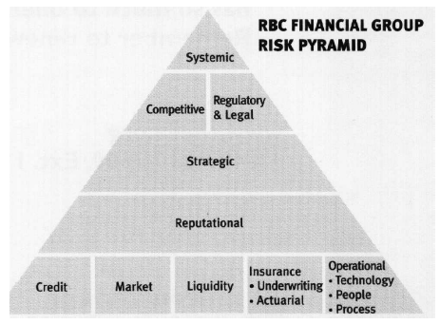
Risk Exposures
Growth in Internet Time
Culture of Risk
Managing Information

Slide 8
Risk Concept
People will evaluate value and risk and at the same time attempt to counterbalance one against the other. If the perceived value is high enough, people may be willing to take the risk to obtain the desired value.

Slide 9
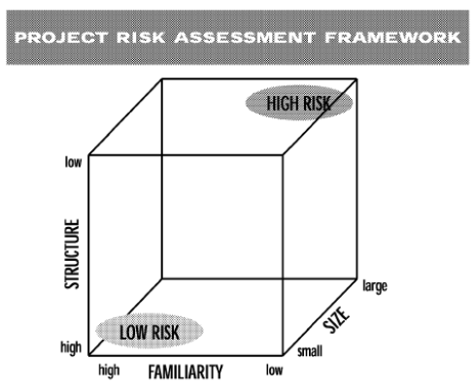
Project Risk Assessment Framework
size,
structure and
familiarity.

Slide 10
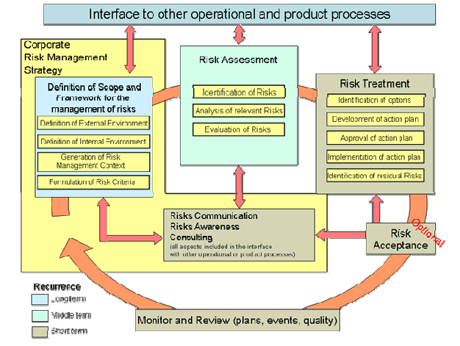
Risk Management Process

Slide 11
Q&A

