Slide 1
Customer relationship management (CRM)
Yoga Mahesa & Hendrik Gunawan

Slide 2
3 Important things in organization
Product / service
SCM
Operational
ERP
Customer
CRM

Slide 3
Customer relationship management (CRM)
a model for managing a company’s interactions with current and future customer

Slide 4
Types of CRM
Operational CRM
Marketing automation
Sales force automation
Service automation
Analytical CRM
Maintains the analysis and operations of an organizational back office.
Strategic CRM
To focus and improve the knowledge of the customer and utilize it in enhancing a strong relationship with customer.
(Matteson, 2013)

Slide 5
CRM B2B and B2C
CRM B2B (Business to Business)
Maintain the relationships with other business. Usually have longer maturity times than B2C relationships.
CRM B2C (Business to Customer)
Maintain the relationships with the customer. Like customer service, membership, birthday greeting, etc.

Slide 6
Implementing
Make a strategic decision
Choose an appropriate project manager
Executive sponsorship
Project team commitment and training
Define KPI metrics
Use phased approach

Slide 7
CRM Software
Pipedrive
Insightly
InfoFlo
SugarCRM
SAP
NetSuite CRM
Microsoft Dynamics CRM
Oracle
etc
(http://crm-software.findthebest.com/)

Slide 8
CRM Growth
Worldwide CRM market revenue totalled $9.15 billion in 2008, a 12.5 percent increase from 2007 revenue of $8.13 billion, according to Gartner Inc. Analysts
http://www.gartner.com/newsroom/id/1074615

Slide 9
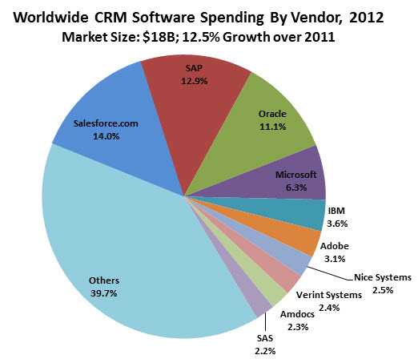
CRM Growth (Cont)
http://www.forbes.com/sites/louiscolumbus/2013/04/26/2013-crm-market-share-update-40-of-crm-systems-sold-are-saas-based/

Slide 10
Why CRM Growth?
Ed Thompson, VP and distinguished analyst at Gartner Research said, “GDP growth is the best indicator of whether people are going to be spending on CRM. But the other factor is that a lot of organizations are concluding that they want to differentiate by having a superior customer experience, and therefore they are looking for technology that will help them with their customers. And that tends to be CRM.”
http://www.mycustomer.com/feature/technology/truth-hurts-why-crm-still-growing-and-still-gruelling/166145

Slide 11
Why CRM Growth? (Cont)
Bill Band, VP and principal analyst at Forrester Research, is in agreement. “In our last survey amongst senior business leaders, we asked them what were the top priorities going into 2013 and into 2014 and the top three issues that were identified as critical or very critical were growing the business, improving customer satisfaction and responding to changing customer needs. Things like cost reduction and supply chain and those kinds of things were way down the list. Why is that important? Everybody’s trying to grow their business and that’s a top priority.”
http://www.mycustomer.com/feature/technology/truth-hurts-why-crm-still-growing-and-still-gruelling/166145

Slide 12
Bibliography
Matteson, L. (2013, March 27). The Three Types of CRM System. Retrieved April 3, 2014, from drivingsales.com: http://www.drivingsales.com/blogs/lmatteson/2013/03/27/the-three-types-crm-systems-

